Slide 1



Arabic books search engine

Slide 2


About us
Mohamed Ahmed
Mohamed Sayed
Yousef Nasser
Mahmoud Mohamed
Keroles Ashraf
Abd Elrahman Awwad

Slide 3
supervisors
Prof. Dr. Howida Shedeed
TA. Nouran El-Said

Slide 4
Agenda
Intorduction
problem definition
Objective
motivation
survay
Dataset
Architecture
Data preparation
embedding techniques
indexing
Query length selection
similarity and Retrieval
Hybard Approach
Future Work
interface
software tool
References

Slide 5



Introduction

Slide 6





Introduction
the Arabic language, with its unique morphology and syntax, presents distinct .
digital libraries and online repositories have become the cornerstone of information dissemination.
arabic language challenges for search engines, limiting their ability to deliver relevant and precise results.

Slide 7
Problem Definition

Slide 8







Problem Definition
Rich Morphology:
Arabic words can take many forms due to prefixes, suffixes, and infixes.
This results in difficulties matching queries with relevant content accurately.
Rich Morphology
كتب
يكتب
كتبت
Diacritics:
significantly alter word meanings but are often inconsistently included in Arabic texts. Search engines struggle with this ambiguity.
Diacritics
Synonyms and Context:
Words in Arabic often have multiple meanings depending on the context. Traditional search engines rely heavily on keyword matching and fail to capture semantic nuances.
Synonyms and Context
شربت الليمون بعد العصر
شربت الليمون بعد العصر

Slide 9
Objectives

Slide 10






Objectives
Develop a search engine tailored for Arabic books.
Enhance search accuracy by addressing Arabic-specific linguistic challenges (e.g., stemming, tokenization,lemmtization).
Combine keyword-based and semantic search techniques to rank results effectively.
Deliver a system that retrieves the top 10 most relevant books for a query.

Slide 11
Motivation

Slide 12


Motivation
Overcoming challenges like diacritics, morphology, and context, enabling accurate and quick access to Arabic literature using advanced NLP techniques.
Basic keyword matching often led to irrelevant or incomplete search results, causing frustration.

Slide 13
Survey

Slide 14
Survey
Paper | Author | year | Algorithm | Dataset | ACCURACY
[1] | Moulay Abdellah KASSIMI , Abdessalam ESSAYAD | 2023 | TF-IDF, word2vec, AraBERT | EveTAR, | TF-IDF = 82.79%, word2vec = 88.03% AraBERT = 67.583%
[2] | Hussein Mozannar, Karl El Hajal, Elie Maamary, and Hazem Hajj | (2019) | TF-IDF Retriever, BERT-based Reader: | Arabic Reading Comprehension Dataset (ARCD), Arabic-SQuAD | BERT = 61.3 %F1 score on ARCD,
[3] | Manal Alamir, Sadeem Alharth, Shahad Alqurashi Tahani Alqurashi | 2021 | TF-IDF, Cosine Similarity | labor law dataset | ROUGE-1 (unigrams): Averaged around 0.6, ROUGE-2 (bigrams): Scored above 0.3

Slide 15
Dataset

Slide 16
Abjjad Arabic books:
We compiled a large, custom Arabic book dataset comprising approximately 31,000 books, each accompanied by detailed textual descriptions. This dataset served as the foundation for our Arabic Book Search Engine and was specifically curated to support the Natural Language Processing (NLP) techniques employed in the project.

Slide 17
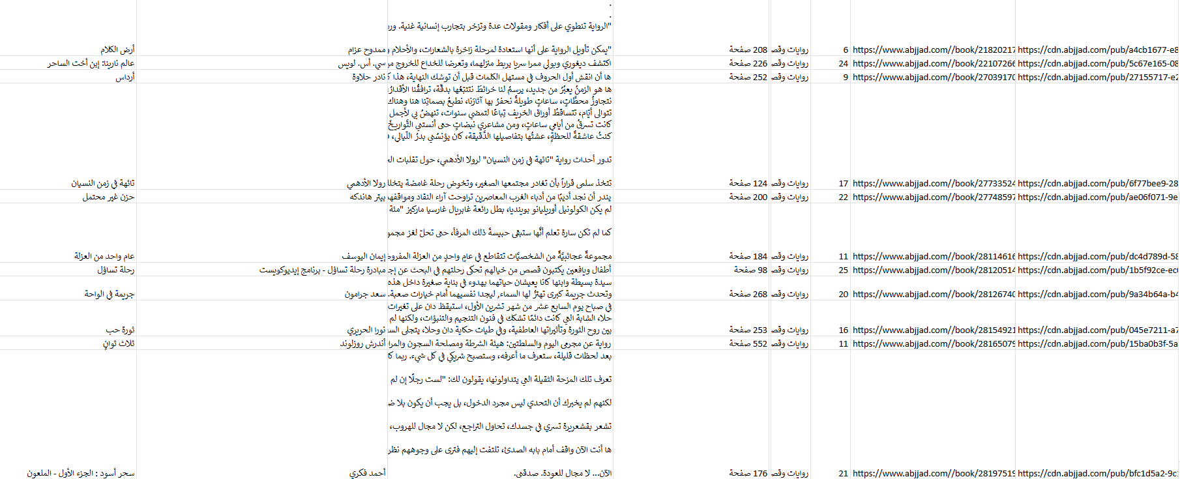
Sample:

Slide 18
System Architecture

Slide 19
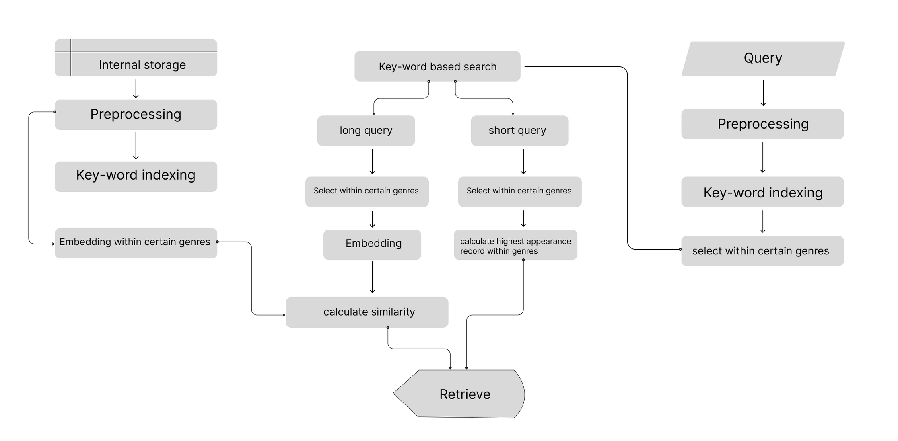
System Architecture

Slide 20



App
Get Book Name / Category from app
TRAINED MODEL
Analyze Search query
and retrive top 10
App
Display Result to User and recommendations

Slide 21
Data preparation

Slide 22


Data preparation:
To ensure that our Arabic Book Search Engine could process and analyze the dataset effectively, we performed a comprehensive data preparation phase. This phase involved text consolidation, cleaning, and normalization of the Arabic text to make it suitable for Natural Language Processing (NLP) tasks.
Text Preprocessing
Before combining the different fields into a single text body, we applied a series of preprocessing steps to clean and normalize the raw Arabic text. This phase was essential for improving the performance of Natural Language Processing (NLP) models by reducing noise and unifying variations in the Arabic language.

Slide 23
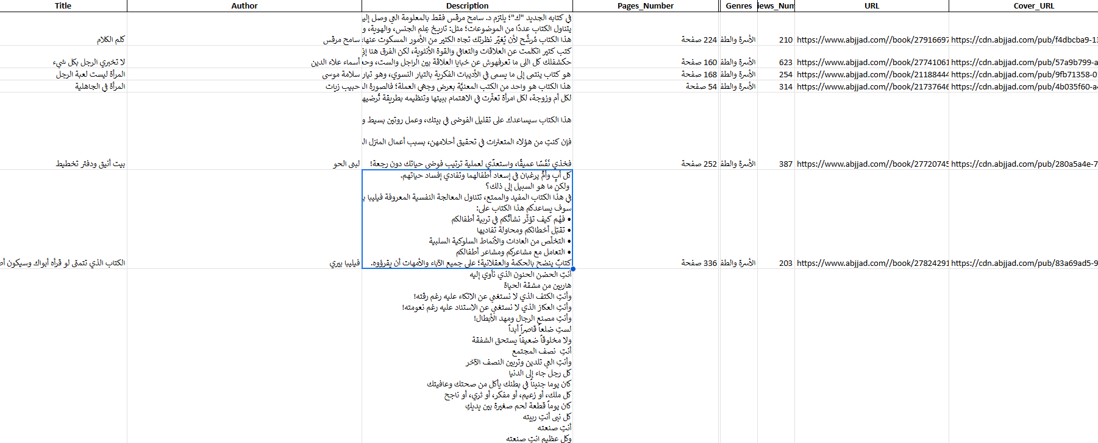
Sample:

Slide 24
Data preprocessing

Slide 25
Preprocessing Steps
Punctuation removal
Whitespace correction
Arabic number elimination
Diacritic removal
Non-Arabic character filtering
Link removal
Stopword removal
Text normalization

Slide 26
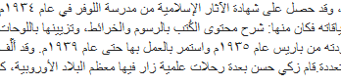
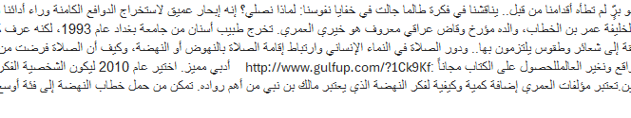
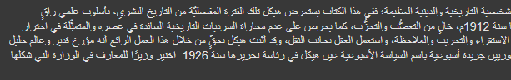
Data Before preprocessing

Slide 27
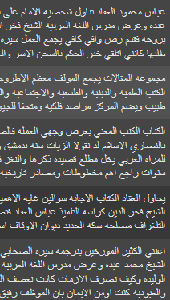
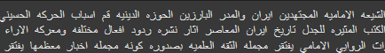
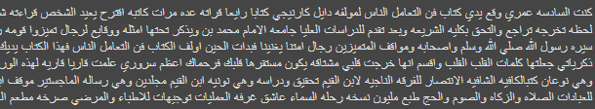
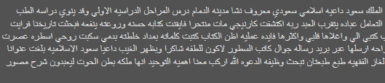
Data After preprocessing

Slide 28
Embedding Techniques

Slide 29
Embedding Techniques
Bag of Words (BoW)
Transformer Embedding
TF-IDF
Weighs word importance.
Weighs word appearance.
Uses models like BERT for context-aware representations.

Slide 30
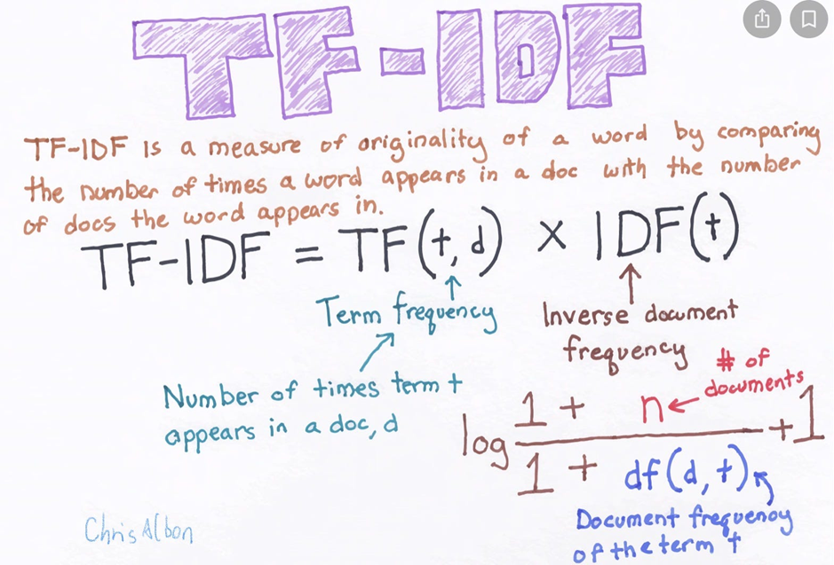
TF-IDF:
is a simple, fast statistical method that uses word frequency to represent text but lacks understanding of context or meaning

Slide 31
TF-IDF:
Using more TF-IDF features (e.g., 10,000) is better when training on rich, descriptive fields like book descriptions, as it captures more nuanced vocabulary—this setup is more effective for handling long queries with detailed context.
Using fewer TF-IDF features (e.g., 5,000) works better when training on concise, merged fields like title, author, and genre, where the vocabulary is more focused—this setup aligns well with short queries that rely on key terms.

Slide 32
Bag of Words (BoW):
Bag of Words (BoW) is a basic text representation method that converts text into fixed-length vectors based on word frequency, ignoring grammar and word order. It creates a vocabulary of unique terms from the corpus and represents each document by counting how often each word appears. While simple and fast, BoW doesn't capture context or semantics, making it best suited for tasks where word presence matters more than meaning.

Slide 33
Bag of Words (BoW):
Using more BoW features (e.g., 10,000) is effective when training on rich text like descriptions, as it preserves more unique terms—this suits long queries that contain detailed or uncommon words.
Using fewer BoW features (e.g., 5,000) performs better when training on merged fields like title, author, and genre, where the language is simpler and more repetitive—this fits short queries that use core keywords.

Slide 34
Transformers:
(e.g.,BERT, AraBERT,all-MiniLM-L6-v2) provide deep semantic understanding by converting text into dense vectors. These are ideal for capturing meaning and handling complex or unseen queries.

Slide 35
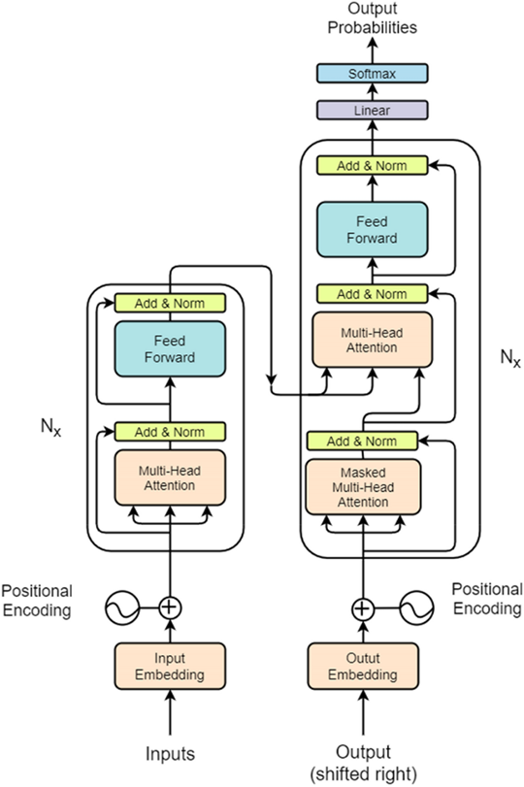
Transformers:
The encoder in the Transformer architecture generates embeddings by processing input tokens through multiple self-attention and feedforward layers. Using Sentence Transformers and Hugging Face models, the encoder captures contextual relationships between words, producing dense vector representations. Sentence Transformers typically apply a pooling strategy (like mean pooling) over the token embeddings from the final encoder layer to create a single fixed-size sentence embedding suitable for tasks like similarity, clustering, or retrieval.

Slide 36
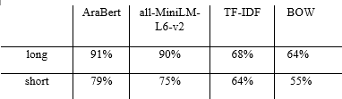
Average Similarity:

Slide 37
Indexing

Slide 38
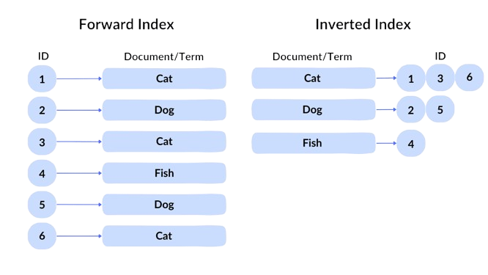
Inverted Indexing
An inverted index is a data structure used by search engines to quickly find all documents that contain a given word or term.

Slide 39
Inverted Indexing construction
An inverted index is a data structure used by search engines to quickly find all documents that contain a given word or term.

Slide 40
3.Query length selection

Slide 41
Query length selection
Short Queries
Longer Queries
ranges from (1 - 10 words)
Pros: Fast, broad matches, good .
Cons: May lack context, leading to ambiguous results.
Ranges from (+10 words)
Advantage: Provides rich context
Limitation: May become overly specific

Slide 42
similarity and Retrieval

Slide 43
similarity and Retrieval
Cosine similarity measures the closeness of text embeddings.
retrieve the top 10 most relevant result.
COSINE SIMILARITY(A, B) = (A · B) / (||A|| × ||B||)

Slide 44
Hybrid Approach

Slide 45
Key-word based search(stage 1):
Keyword-based search matches user queries to documents by identifying overlapping terms. It relies on an inverted index that maps keywords to relevant documents, making it fast and effective—especially for short queries with clear, specific terms

Slide 46
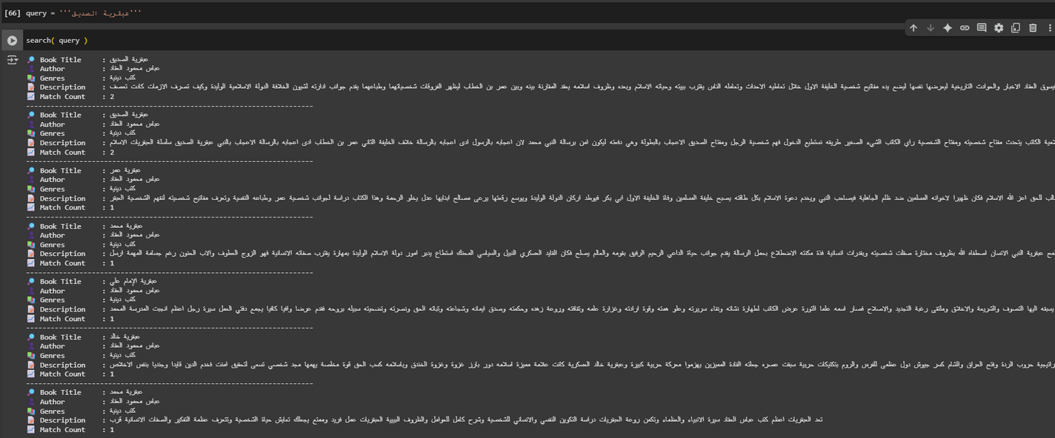
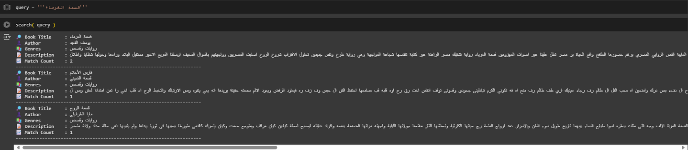
Stage 1
Key-word based search:

Slide 47
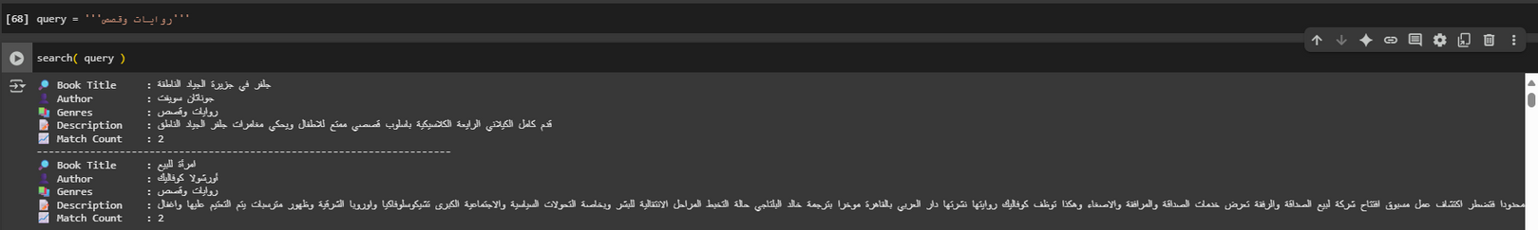
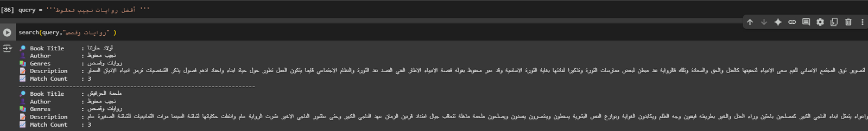
Stage 1
Key-word based search:

Slide 48
Embedding based search(stage 2):
Embedding-based search represents queries and documents as dense semantic vectors using pretrained language models. It captures the meaning and context of text, enabling accurate matching even when the query and documents use different words or phrasing. This makes it highly effective for long or complex queries, where user intent is better expressed.

Slide 49
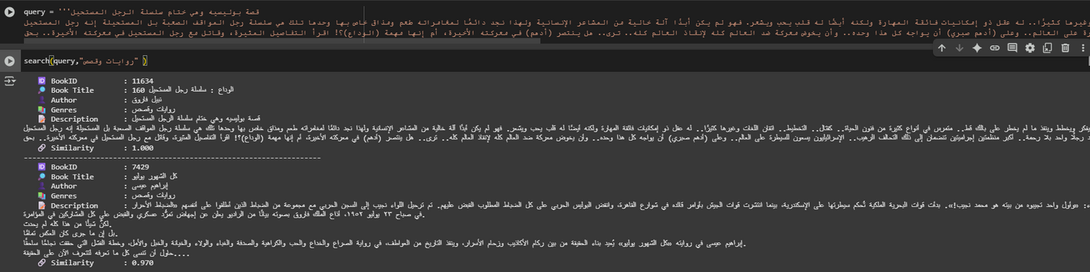
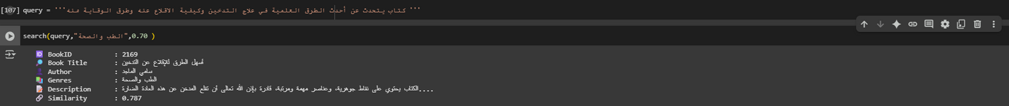
Stage 2
Embedding based search:

Slide 50
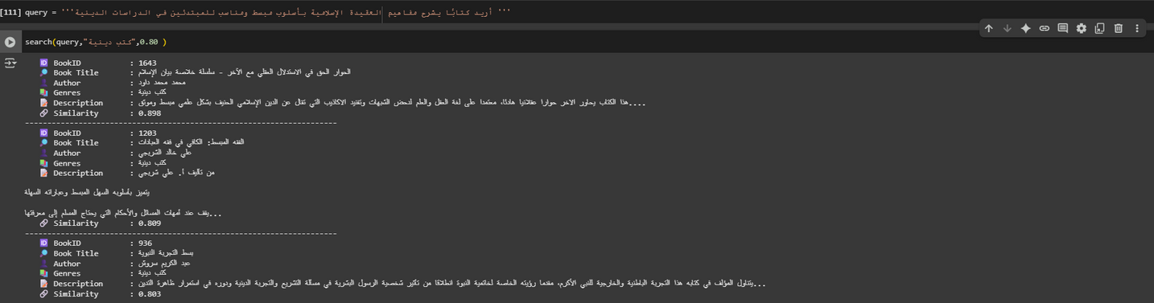
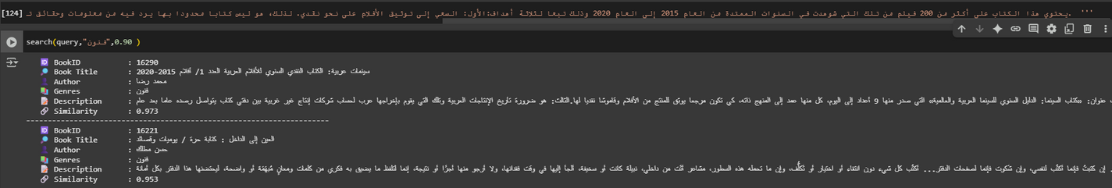
Stage 2
Embedding based search:

Slide 51
Future work

Slide 52
Future Work:
·Feedback-Driven Refinement: Integrate user relevance feedback to continuously fine-tune ranking models.
·Full-Text Support: Extend indexing and embedding beyond descriptions to include complete book content.
·Multilingual Capability: Support cross-lingual searches by embedding Arabic and foreign-language texts into a shared vector space.
·Production-scale Deployment: Optimize system components for deployment in real-world environments, focusing on efficiency and scalability.

Slide 53
Interface

Slide 54
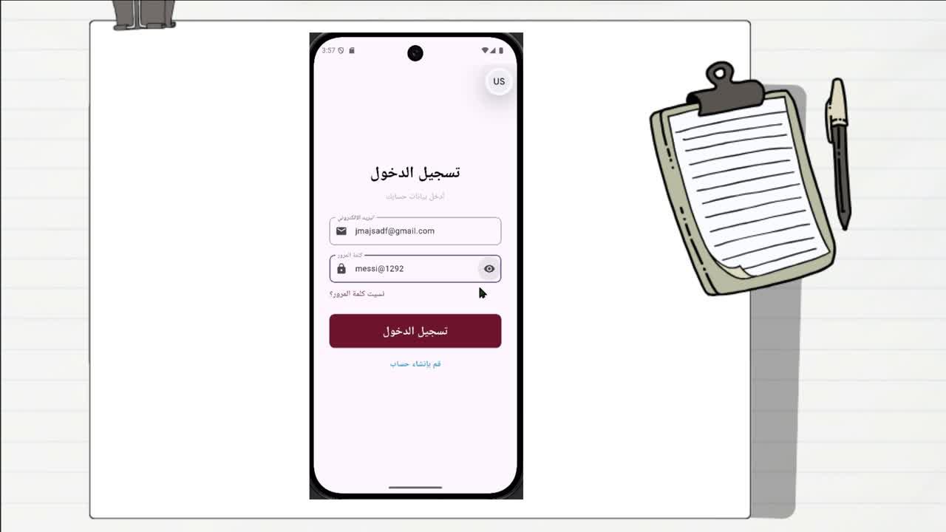

Slide 55
Software Tools

Slide 56






Software Tools
Flutter
Firebase
Python
Hugging Face
Tensorflow
Flask

Slide 57
References

Slide 58

REFERENCES
[1] M. A. Kassimi and A. Essayad, “BERT Representation for Arabic Information Retrieval: A Comparative Study,” Multimedia Research, vol. 6, no. 3, pp. 1–12, 2023.
[2] M. A. Kassimi, H. Abdellatif, and A. Essayad, “Mono-Lingual Search Engine: Combining Keywords with Context for Semantic Search Engine,” in Advances in Intelligent System and Smart Technologies, Lecture Notes in Networks and Systems, vol. 826, Springer, 2024, pp. 353–361.
[3] A. El Hadi, Y. Madani, R. El Ayachi, and M. Erritali, “A New Semantic Similarity Approach for Improving the Results of an Arabic Search Engine,” Procedia Computer Science, vol. 151, pp. 1170–1175, 2019.
[4] Darwish et al. (2021) provide a broad overview, including Arabic IR with discussions on stemming, diacritization, embeddings, and semantic search.
[5] A full pipeline including Arabic text normalization, TF–IDF vectorization, inverted-index construction, and a Flask search API.

Slide 59

Thank You

